Slide 1
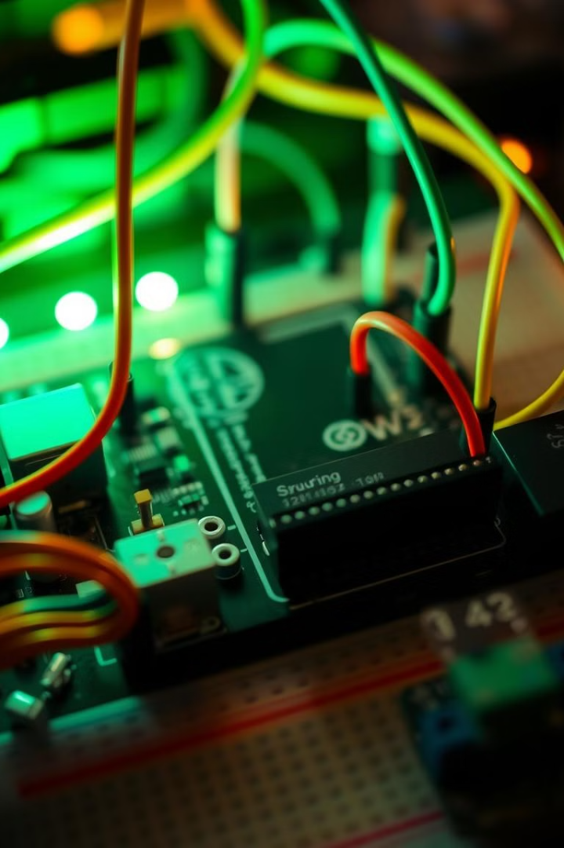

Arduino Powered Numbers Conversion System
This project demonstrates how to build a simple numbers conversion system using an Arduino microcontroller. It will convert a user-input number from one base to another.
by Vinay Velpula

Slide 2
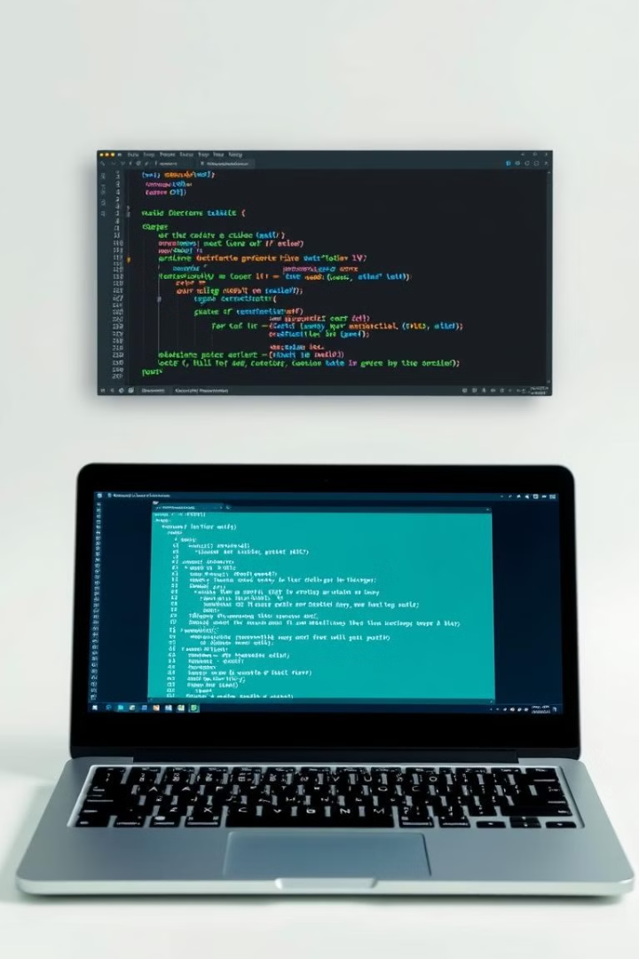
Software Setup
1
Arduino IDE
2
Libraries
Start by installing the Arduino IDE, a user-friendly software platform for programming and uploading code to Arduino boards.
Consider using the LiquidCrystal library to interact with a basic LCD display for outputting the converted numbers.

Slide 3
Number Input
Keypad
Display
Use a 4x4 keypad for users to input the number they wish to convert.
An LCD display or a seven-segment display can be used to display the input number before and after conversion.

Slide 4
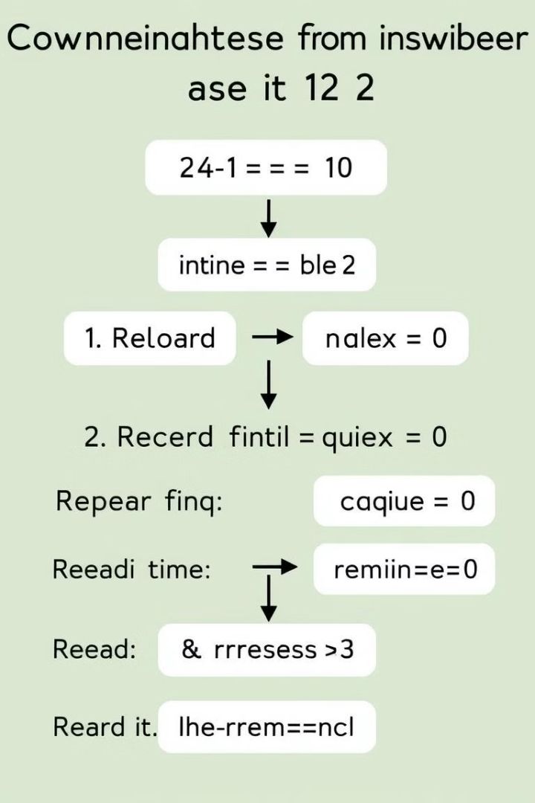



Conversion Algorithm
Input Number
The system starts by receiving the number to convert.
Base Identification
Determine the original base of the input number.
Conversion Logic
Apply the appropriate algorithm to convert the input number to the desired base.

Slide 5
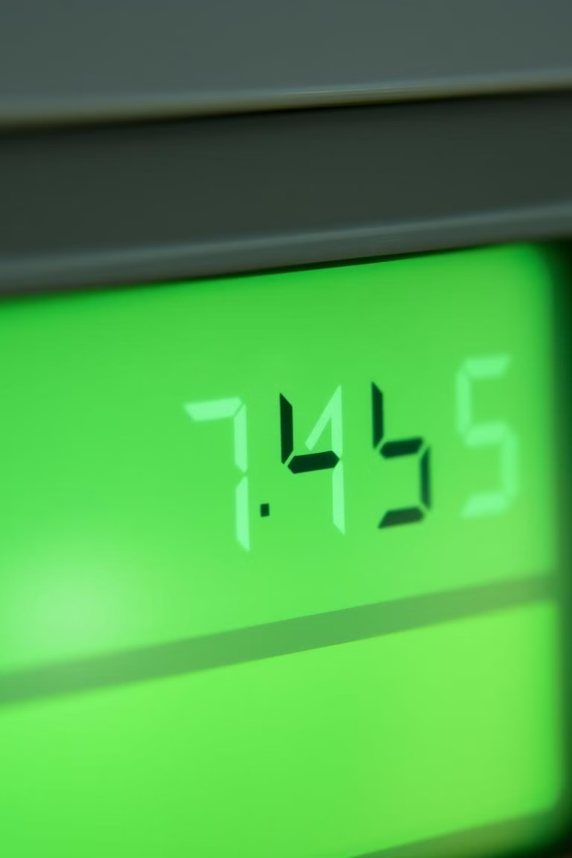
Output Display
LCD
Use an LCD display for displaying the converted number in a clear and readable format.
Seven-Segment
Seven-segment displays are common options for showing converted numbers.

Slide 6
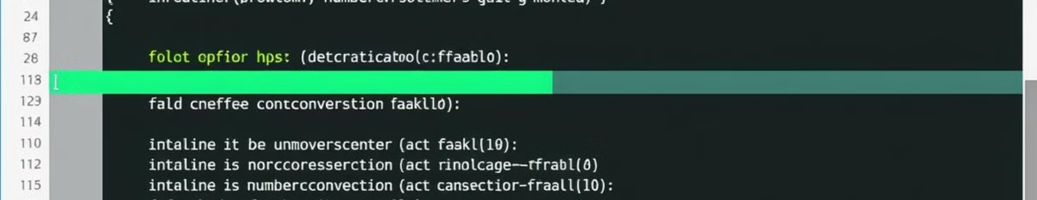
Arduino Code
Input Handling
Conversion Logic
Output Display
Code for reading input from the keypad.
Implement the conversion algorithm based on the chosen bases.
Code to display the converted number on the chosen display.

Slide 7
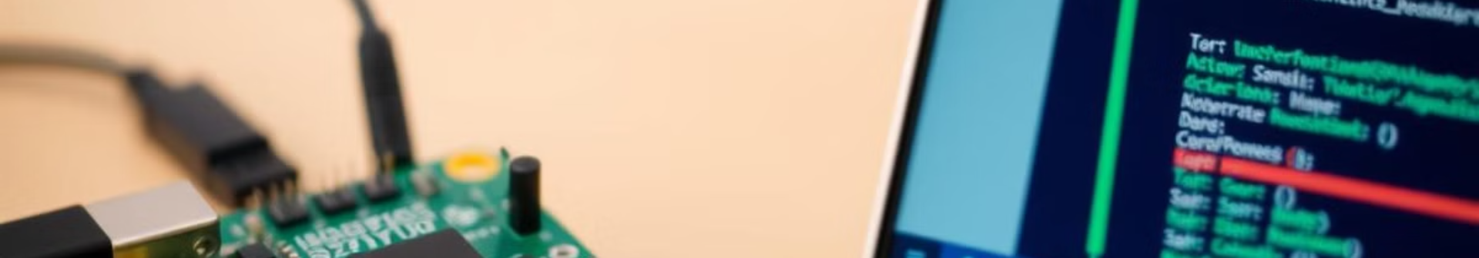
Testing and Debugging
Verification
1
Test the system with various numbers and ensure that the output matches the expected values.
2
Debugging
Use the serial monitor to observe the data flow and identify any errors.
Fine-tuning
3
Refine the code based on the testing results and address any observed issues.

Slide 8



Application
Educational Tool
Basic Calculator
A useful tool for teaching basic number systems and conversion concepts.
Extend the functionality to include other mathematical operations and functions.

Slide 9

Future Enhancement
1
Multi-Base Conversion
2
Graphical Interface
Implement the system to handle conversion between various bases like binary, octal, hexadecimal, and decimal.
Develop a graphical interface to control the system and visualize the conversion process.

Slide 10
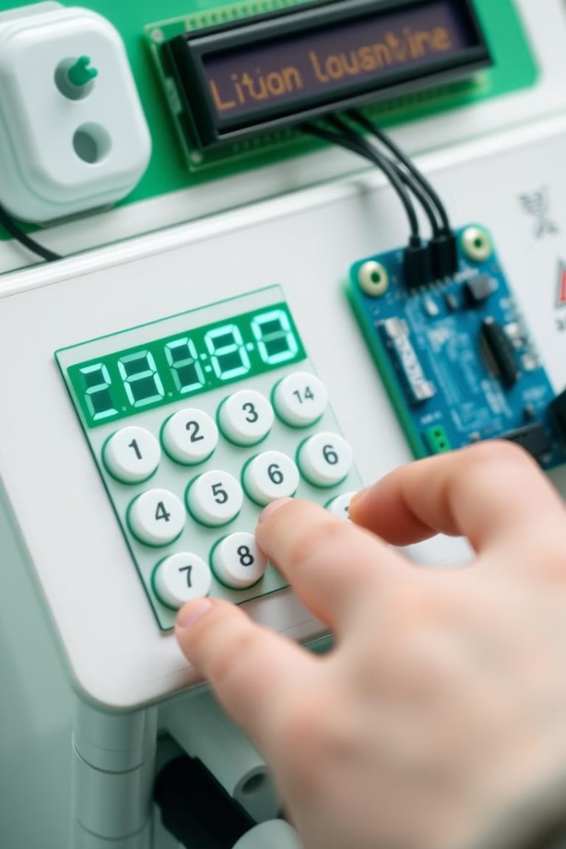
Conclusion
This project demonstrates the potential of Arduino microcontrollers for creating practical and educational tools. By combining hardware and software elements, we can build systems that enhance our understanding of number systems and their conversion.

